Slide 1





Javascript

Slide 2
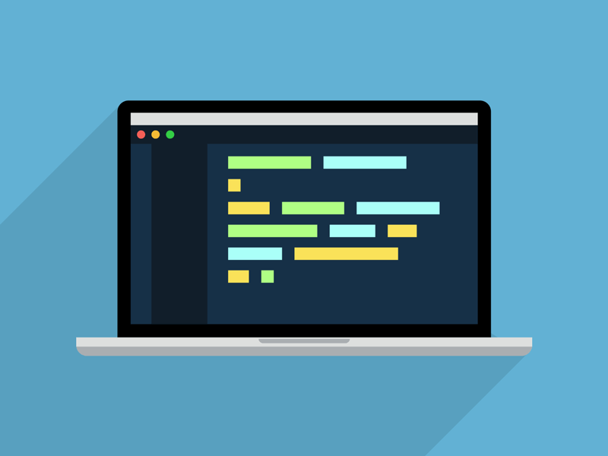

Contents
Introduction
History
ECMAScript
ECMAScript Official Website
Process info- graph
How to add JavaScript in html?
JavaScript Syntax

Slide 3
JavaScript Variables
Datatypes
Array
Strings
Date and Time
Math
Looping
Advantages
Applications
Summary

Slide 4

Introduction about JS
JavaScript is a lightweight, cross-platform, single-threaded, and interpreted compiled programming language. It is also known as the scripting language for webpages. It is well-known for the development of web pages, and many non-browser environments also use it.
JavaScript is weakly typed language (dynamically typed). JavaScript can be used for client side developments as well as server-side developments. JavaScript is both an imperative and declarative type of language. JavaScript contains a standard library of objects, like array , date and math and a core set of language elements like operators, control structures, and statements.

Slide 5
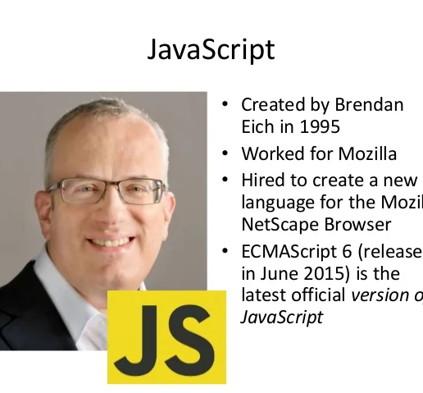
History & Features
IT was created in 1995 by Brendan Eich while he was an engineer at Netscape. It was originally going to be named Live Script but was renamed. Unlike most programming languages, JavaScript language has no concept of input or output. It is designed to run as a scripting language in a host environment, and it is up to the host environment to provide mechanisms for communicating with the outside world.
The most common host environment is the browser.
Features are:-
JavaScript was created in the first place for DOM manipulation. Earlier websites were mostly static, after JS was created dynamic Web sites were made.
Can handle date and time.
Performs Form Validation although the forms are created using HTML.
No compiler is needed

Slide 6
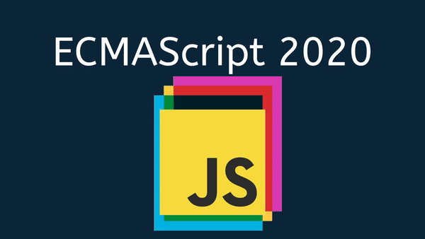

ECMAScript
ES6 or ECMAScript 2015 is the 6th version of the ECMAScript programming language. ECMAScript is the standardization of JavaScript which was released in 2015 and subsequently renamed as ECMAScript 2015.
It is the specification defined in ECMA-262 for creating a general-purpose scripting language. In simple terms, it is a standardization for creating a scripting language. It was introduced by ECMA International and is an implementation with which we learn how to create a scripting language.
Date : 23 January 2024 Info : ECMAScript
More Info : ES6 introduced several key features like const, let, arrow functions, template literals, default parameters, and a lot more

Slide 7
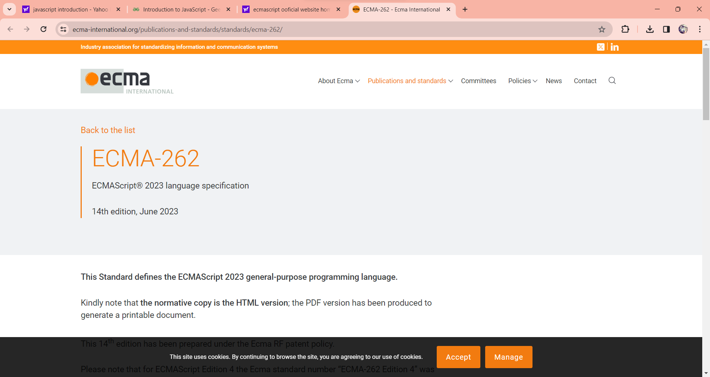
ECMAScript Official Website

Slide 8
Process Info-Graph
1
2
3
4
HTML
CSS
JAVASCRIPT
JS Framework
Frontend Website
More Attractive
Responsive

Slide 9

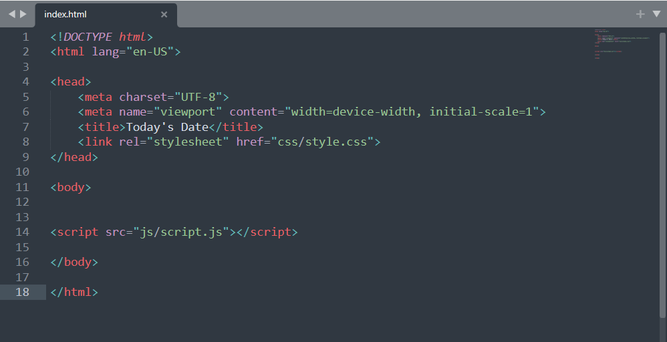
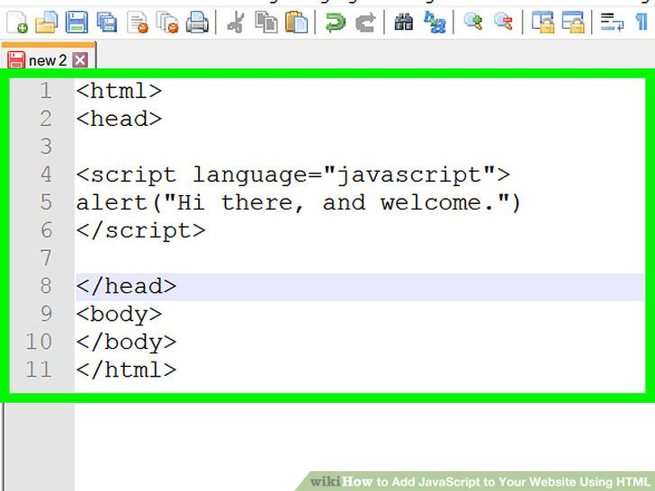
How to add JavaScript in html document ?
In head section and Body section of html

Slide 10
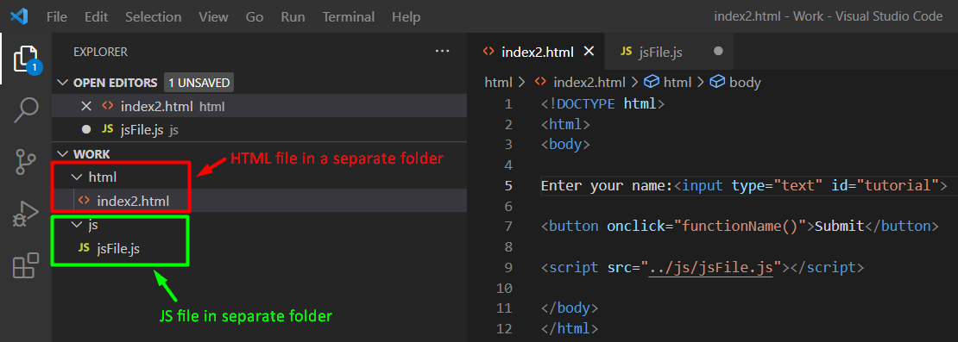
How to add JavaScript in html document ?
In External file saved with extension . JS

Slide 11

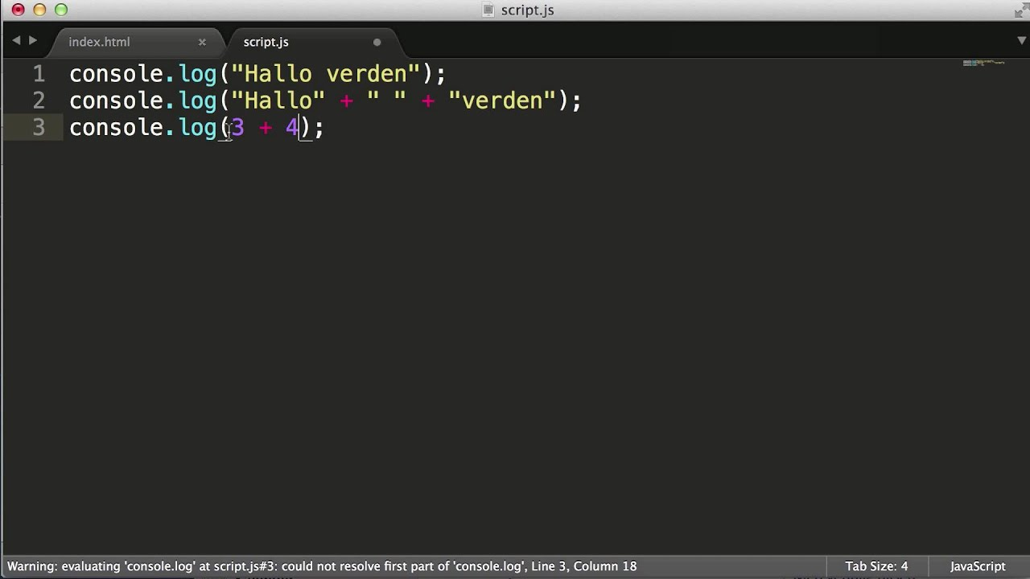
JavaScript Syntax
JavaScript Syntax is used to define the set of rules to construct a JavaScript code. You need to follow all these so that you can work with JavaScript.
Syntax: To print anything= console . log ( “ Hello World I am Ankush ! ” )
Variable Declaration: let ashuu= “” ; , const cyy ;
Assign values to variables: c=5; d=t; g=k/y;

Slide 12

JavaScript Variables

Slide 13
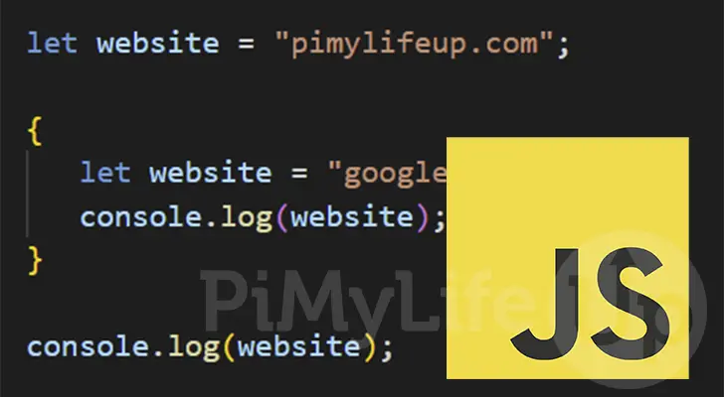
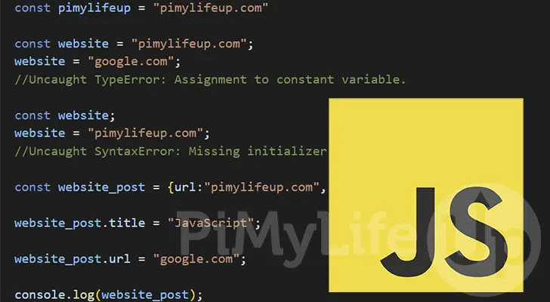

let variable
const variable
Syntax:
let name1;
let name1=name2;
let name1=value1,name2=value2;
let name1,name2=value1
Syntax:
const name1;
const name1=name2;
const name1=value1,name2=value2;
const name1,name2=value1

Slide 14
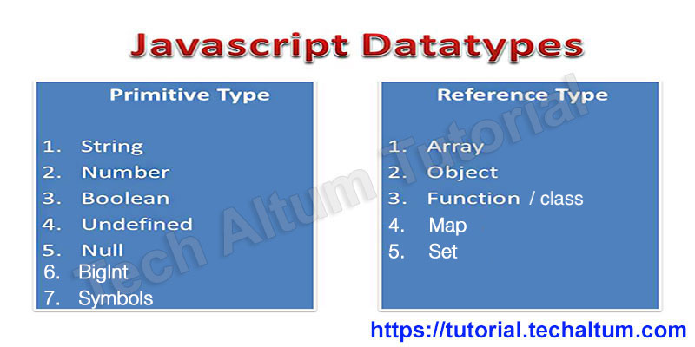
Datatypes
JavaScript provides different datatypes to hold different values on variables. JavaScript is a dynamic programming language, which means do not need to specify the type of variable. There are two types of data types in JavaScript.
Primitive data type
Non-primitive (reference) data type

Slide 15
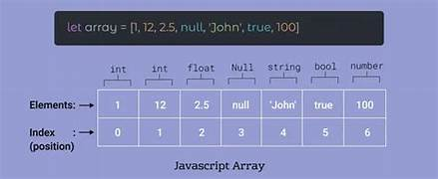
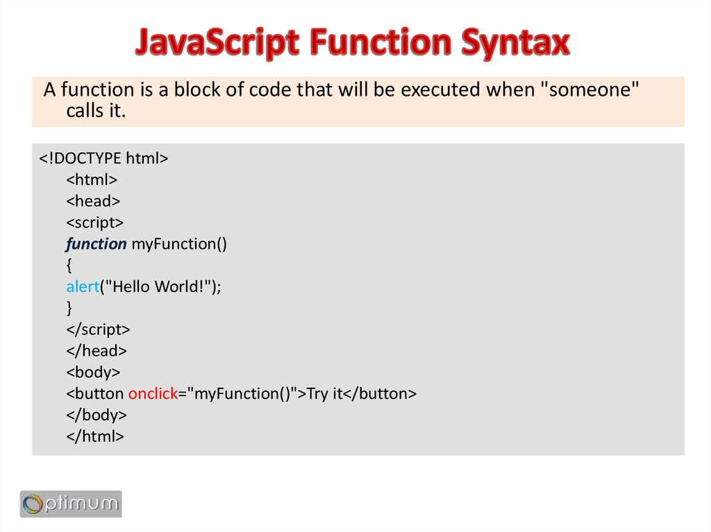
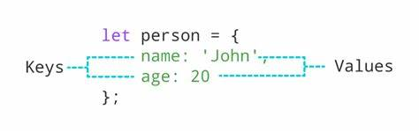
Datatypes

Slide 16
Array
JavaScript Array is a data structure that allows you to store and organize multiple values within a single variable. It is a versatile and dynamic object. It can hold various data types, including numbers, strings, objects, and even other arrays. Arrays in JavaScript are zero-indexed i.e. the first element is accessed with an index 0, the second element with an index of 1, and so forth.
Syntax = let arrayname = new Array( ); , example = let fruits = new Array ( ‘mango’ , ‘guava’ , ‘pineapple’ ) ;
Basic Operations on JavaScript Arrays:-
Accessing Elements of an Array : let fruits = new Array ( ‘mango’ , ‘guava’ , ‘pineapple’ ) ;
console.log( fruits [ 1 ] );
Accessing the Last Element of an Array : let fruits = new Array ( ‘mango’ , ‘guava’ , ‘pineapple’ ) ;
console.log( fruits . Length - 1 );
Accessing the no. of element present in Array : let fruits = new Array ( ‘mango’ , ‘guava’ , ‘pineapple’ ) ;
console.log( fruits . Length );

Slide 17

JavaScript Strings
JavaScript String is a sequence of characters, typically used to represent text. It is enclosed in single or double quotes and supports various methods for text manipulation.
Basic Terminologies of JavaScript String
String: A sequence of characters enclosed in single (‘ ‘) or double (” “) quotes.
Length: The number of characters in a string, obtained using the length property.
Index: The position of a character within a string, starting from 0.
Concatenation: The process of combining two or more strings to create a new one.
Substring: A portion of a string, obtained by extracting characters between specified indices.

Slide 18

Strings Methods
JavaScript slice ( startindex , endindex ) method
JavaScript substring ( startindex , endindex ) method
JavaScript replace ( replace value, replace with ) method
JavaScript replaceAll ( regExp | Substr, substr2 ) method
JavaScript toUppercase ( string variable ) method
JavaScript toLowercase ( string variable ) method
JavaScript split (character ) method
JavaScript trim ( ) method

Slide 19

Date and time
Let’s meet a new built-in object: Date. It stores the date, time and provides methods for date/time management.
For instance, we can use it to store creation/modification times, to measure time, or just to print out the current date.
Creation :-
To create a new Date object call new date ( ) with one of the following requirements.
New Date ( ) – without arguments create a Date object for the current Date and time.
Let now= new Date( );
alert ( now ); // shows current date and time
Let date= new Date( “23-01-2024” );
alert ( date ); // shows current date

Slide 20
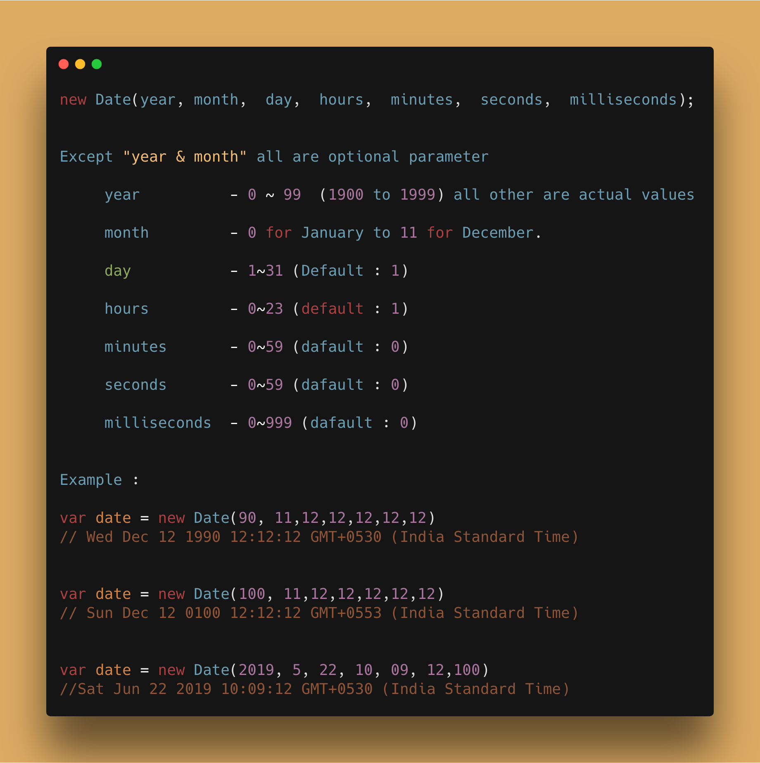
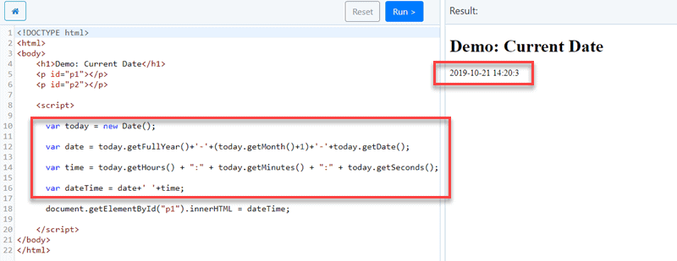
Date and time
Access Date Components :-
getFullyear ( )
getMonth( )
getDate ( )
getDay ( )
getHours ( )
getMinutes ( )
getSeconds( )
getmilliSeconds ( )

Slide 21
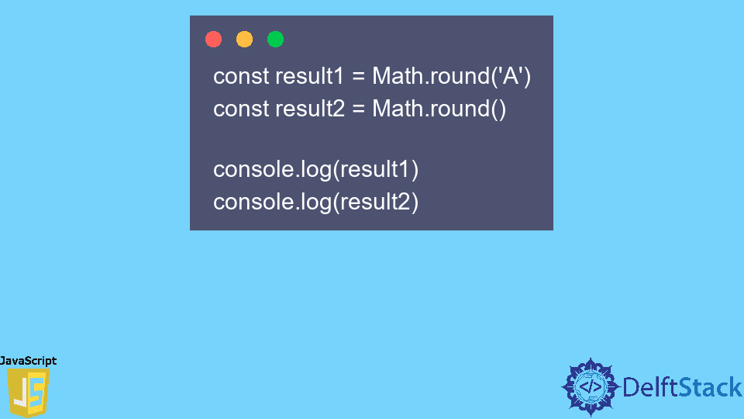
JavaScript Math
JavaScript Math object is used to perform mathematical operations on numbers. All the properties of Math are static and unlike other objects, it does not have a constructor.
We use Math only on Number data type and not on Bigint.
Math Object works with the Number type. The Math object does not have a constructor. All properties and methods of Math are fixed/static. The cosine function is known as Math.cos (y) while the constant pi is known as Math.PI, where y is the method’s argument. All the properties and methods of Math are static and can be called by using Math as an object without creating it.

Slide 22
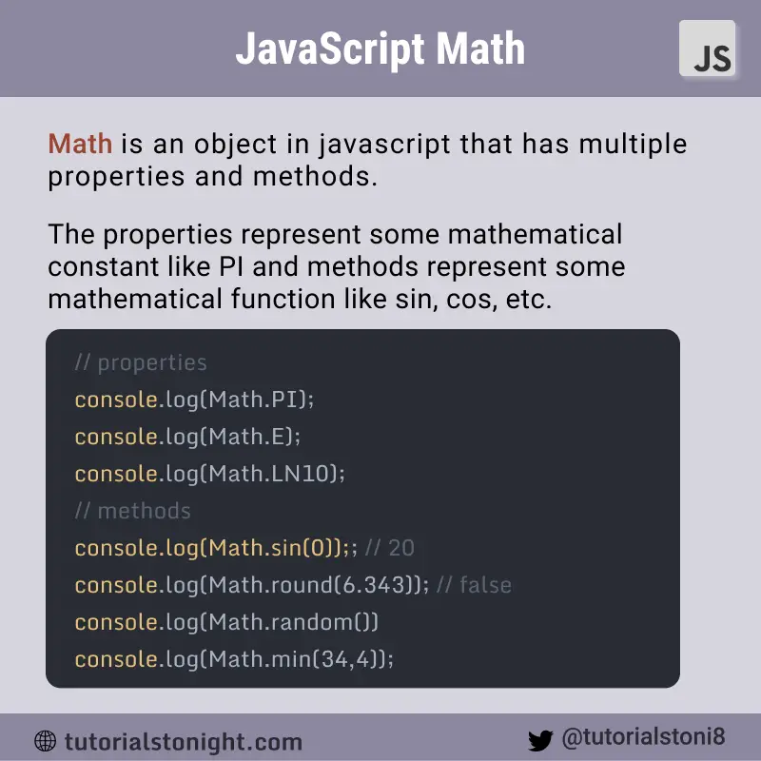
Math Methods
abs () = It returns the absolute value of given no.
acos () = it returns the arccosine of given no. in radians
asin () = it returns the arcsine of the given no. in radians.
aceil () = it returns the smallest no. , greater and equal to given no.
floor () = it returns the largest integer value, greater & equal to no.
max () = it returns maximum value of the given no.
min () = it returns minimum value of the given no.
Pow () = it returns value of base to the power of exponent.

Slide 23

Looping
Looping in programming languages is a feature that facilitates the execution of a set of instructions/functions repeatedly while some condition evaluates to true. For example, suppose we want to print “Hello World” 10 times. This can be done in two ways as shown below:
Iterative Method: The iterative method to do this is to write the console.log() statement 5 times.
Using Loops: In Loop, the statement needs to be written only once and the loop will be executed 5 times as shown below:

Slide 24
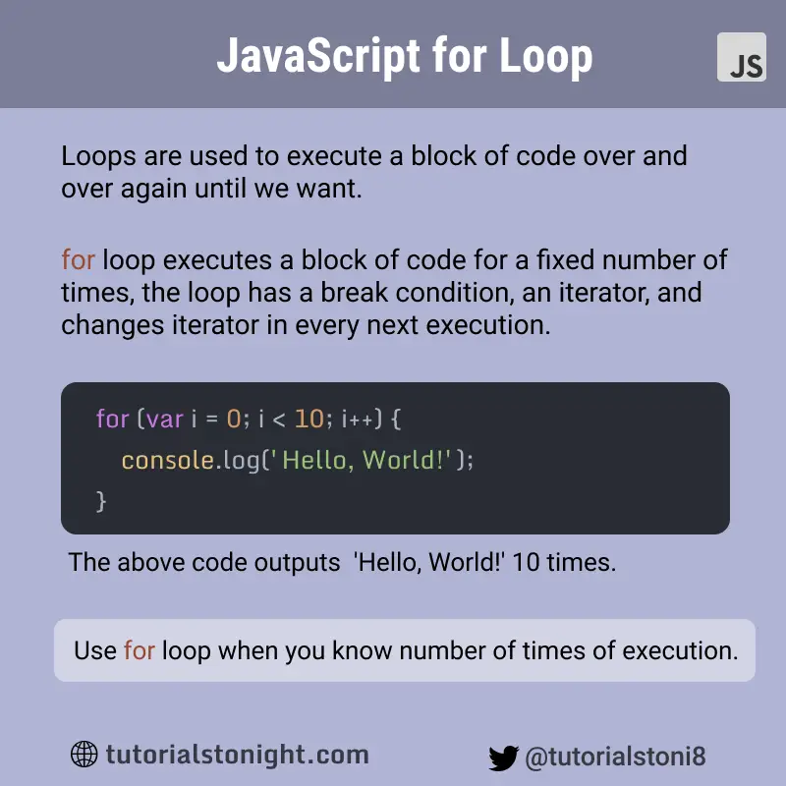
Looping types
For loop :-
for loop provides a concise way of writing the loop structure. Unlike while loop, a for statement consumes the initialization, condition, and increment/decrement in one line thereby providing a shorter, easy-to-debug structure of looping.
Initialization condition: Here, we initialize the variable in use. It marks the start of a for loop. An already declared variable can be used or a variable can be declared, local to loop only.
Testing Condition: It is used for testing the exit condition for a loop. It must return a boolean value. It is also an Entry Control Loop as the condition is checked prior to the execution of the loop statements.
Increment/ Decrement: It is used for updating the variable for the next iteration.
.

Slide 25
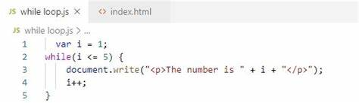
While loop
While loop :-
A while loop is a control flow statement that allows code to be executed repeatedly based on a given Boolean condition. The while loop can be thought of as a repeating if statement.
While loop starts with checking the condition. If it is evaluated to be true, then the loop body statements are executed otherwise first statement following the loop is executed. For this reason, it is also called the Entry control loop
Once the condition is evaluated to be true, the statements in the loop body are executed. Normally the statements contain an updated value for the variable being processed for the next iteration.
.

Slide 26
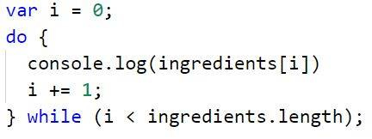
Do While loop
Do While loop:-
A while loop is a control flow statement that allows code to be executed repeatedly based on a given Boolean condition. The while loop can be thought of as a repeating if statement.
While loop starts with checking the condition. If it is evaluated to be true, then the loop body statements are executed otherwise first statement following the loop is executed. For this reason, it is also called the Entry control loop
Once the condition is evaluated to be true, the statements in the loop body are executed. Normally the statements contain an updated value for the variable being processed for the next iteration.
.

Slide 27
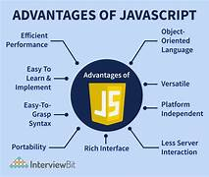
Advantages of JS
Saves time and bandwidth: Regardless of where you host JavaScript, it always gets executed on the client environment to save lots of bandwidth and make the execution process fast.
Easily send HTTP requests: In JavaScript, XMLHttpRequest is an important object that was designed by Microsoft. The object calls made by XMLHttpRequest as an asynchronous HTTP request to the server to transfer the data to both sides without reloading the page
Compatible for all browsers: The biggest advantage of JavaScript having the ability to support all modern browsers and produce an equivalent result.
Vastly used: JavaScript is employed everywhere on the web
Open source: Many open-source projects provide useful help for developers to add JavaScript.

Slide 28
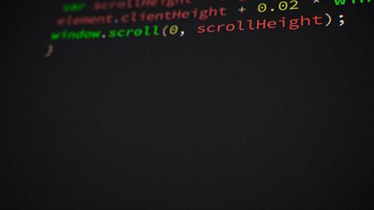
Applications of JS
In the Field of Web Development
Single page applications ( spa )
Mobile App Development
Game Development
Web server and Server Applications
App For Smart Watches
Making Drawing Applications
Making charts and Representations
Presentations
Machine Learning with javascript

Slide 29
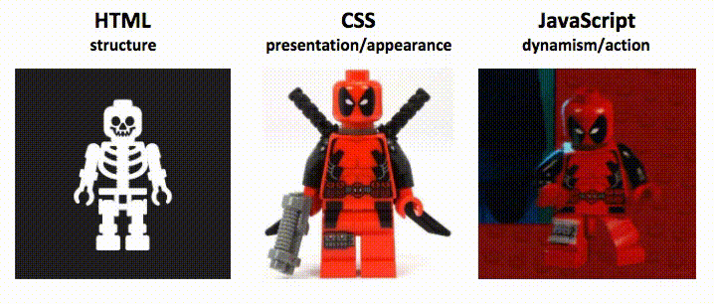
Summary
JavaScript was initially created as a browser-only language, but it is now used in many other environments as well.
Today, JavaScript has a unique position as the most widely-adopted browser language, fully integrated with HTML/CSS.
There are many languages that get “ transpiled ” to JavaScript and provide certain features. It is recommended to take a look at them, at least briefly, after mastering JavaScript.

Slide 30


This Presentation is Prepared by
“Ankush Kumar Mishra”

